Slide 1

Tata Institute of Social Sciences,
Mumbai, INDIA
BA Programme in Social Sciences
Offered from
Off-Campuses – Tuljapur, Hyderabad, Guwahati

Slide 2
Rationale of the Programme
Declining significance of social science as a relevant choice in career
Conventional teaching lacks relevance and responsiveness to the challenges and complexities of understanding and intervening in contemporary issues of significance
Education should engender a broad commitment to democratic values and to strengthen efforts to create a people-centred, ecologically sustainable and just society.
The BASS Programme is visualized to be in tune with the core mission of TISS to be able “to explore fresh ground in defining social sciences knowledge and its relevance in building human services professional.”

Slide 3
Objectives
To make social sciences rigorous as well as attractive to the students
To provide multi-disciplinary, inter-disciplinary and transdisciplinary education in social sciences through horizontal and vertical integration of various disciplines
To provide scope for democratic and reflective thinking, and development of concern for the common good
To provide holistic learning experience through integrating social sciences with natural sciences.
Theoretical orientations that integrate factual knowledge into broader frames of understanding; and methodological skills that put knowledge and understanding into practice.

Slide 4
Structure of the Programme
Three years course of BA in social sciences, plus two years of MA programme offered within the Campus.
Exit Option for the students after completion of three years.

Slide 5
Structure of the Curriculum
Three types of courses:
Perspective Building courses (Core disciplines of Social Sciences and interdisciplinary courses)
Skill development courses (English, Marathi, Mathematics and Logical Reasoning, Basic Statistics and Natural Sciences)
Experiential Learning courses
Special features
Self Study
Research Dissertation

Slide 6
Experiential learning: The Objectives
This course offer an opportunity to learn from outside the classroom. The objectives are:
To provide an opportunity to students to venture into various social settings to gain first hand experience
To enable the students to learn through reflecting upon their experiences

Slide 7
Structure of the Curriculum. . . (contd.)
Year-I
Perspective Building Courses- 5 courses (20 credits)
Skill Development Courses- 6 courses (12 credits)
Experiential Learning Course- 1 course (2 credits)
Year-II
Perspective Building Courses- 6 courses (24 credits)
Skill Development Courses- 5 courses (10 credits)
Experiential Learning Course- 1 course (non-credited)
Year-III
Perspective Building Courses- 1 course (4 credits)
Self-Study courses- 1 course (2 credits)
Research Dissertation- 1 course (6 credits)

Slide 8
Strength/Uniqueness of the Programme
Multidisciplinary, inter-disciplinary and transdisciplinary approach to study social sciences
Integration of mathematics and natural-sciences into the social-sciences curriculum
Experiential Learning as part of the curriculum
Academic experience of historical sites
Civil Society Organizations working on rural issues
Village life
Learning through internship
Emphasis on reflective thinking through research
Seminar papers
Self-study papers
Research dissertation

Slide 9
Learning Process
Pedagogy:
Classroom lectures
Seminar/Discussion mode
Audio-visual files
Modes of Assessment
Written examinations
Individual and Group presentations
Research papers
Documentary making and other creative modes of presentations e.g. street-play
Conferences and Seminars
Students presented papers in National and International level seminars
Feedback system to modify and revise the course content and curriculum

Slide 10
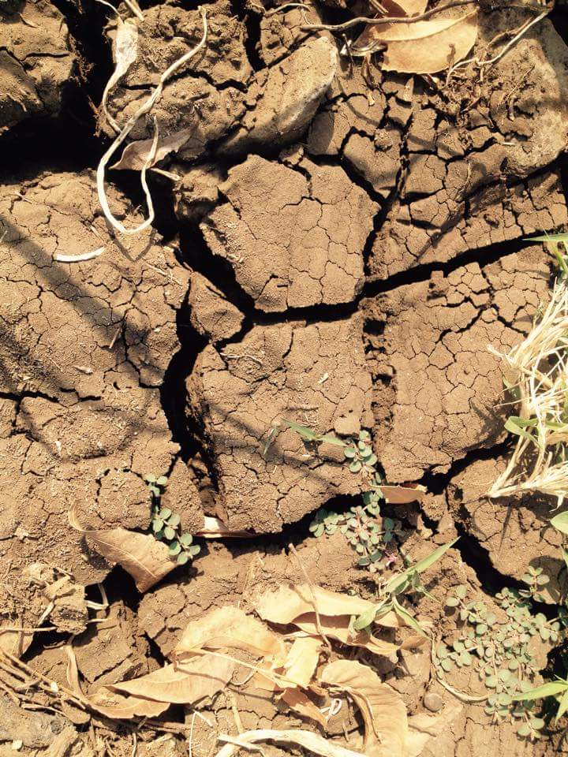
Seeing is believing: Drought in Marathwada

Slide 11
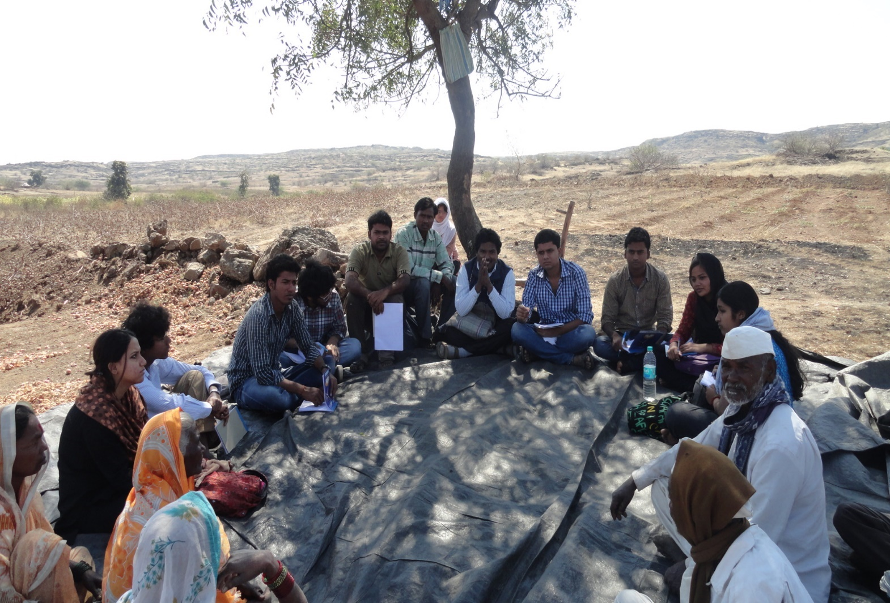
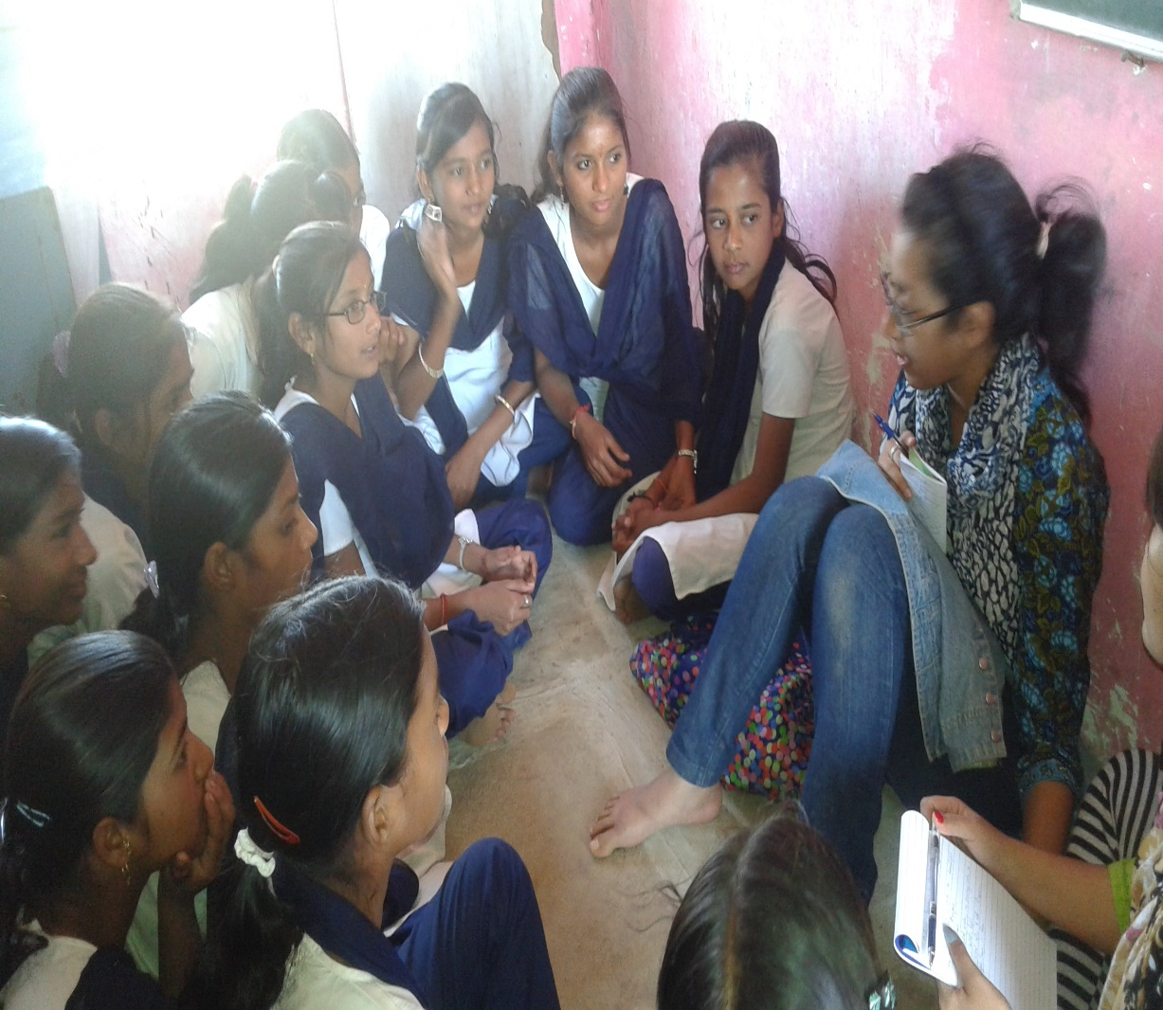
Learning from people

Slide 12
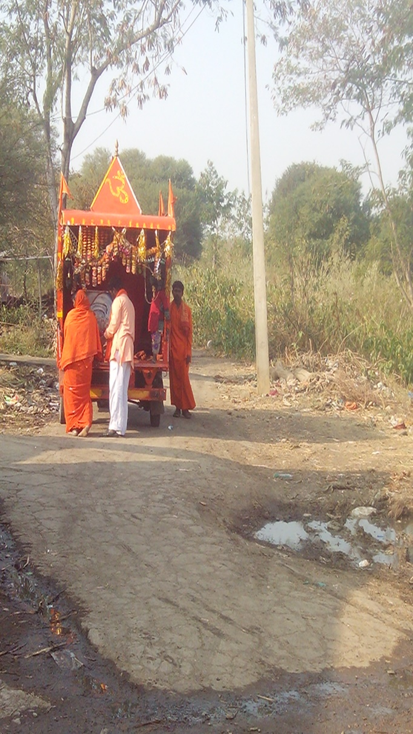
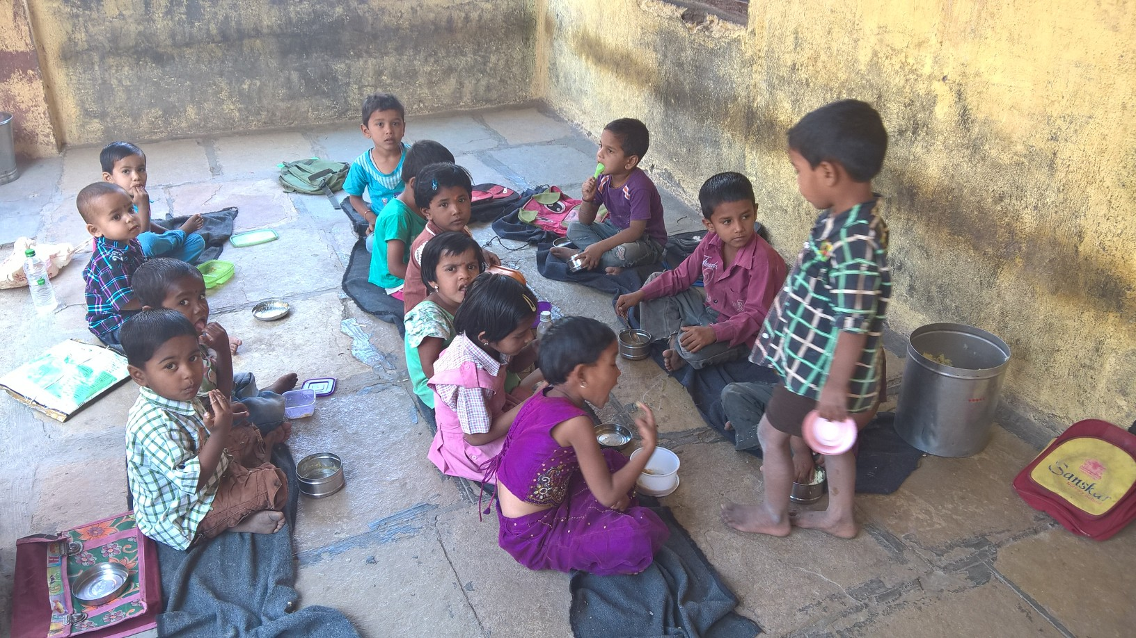
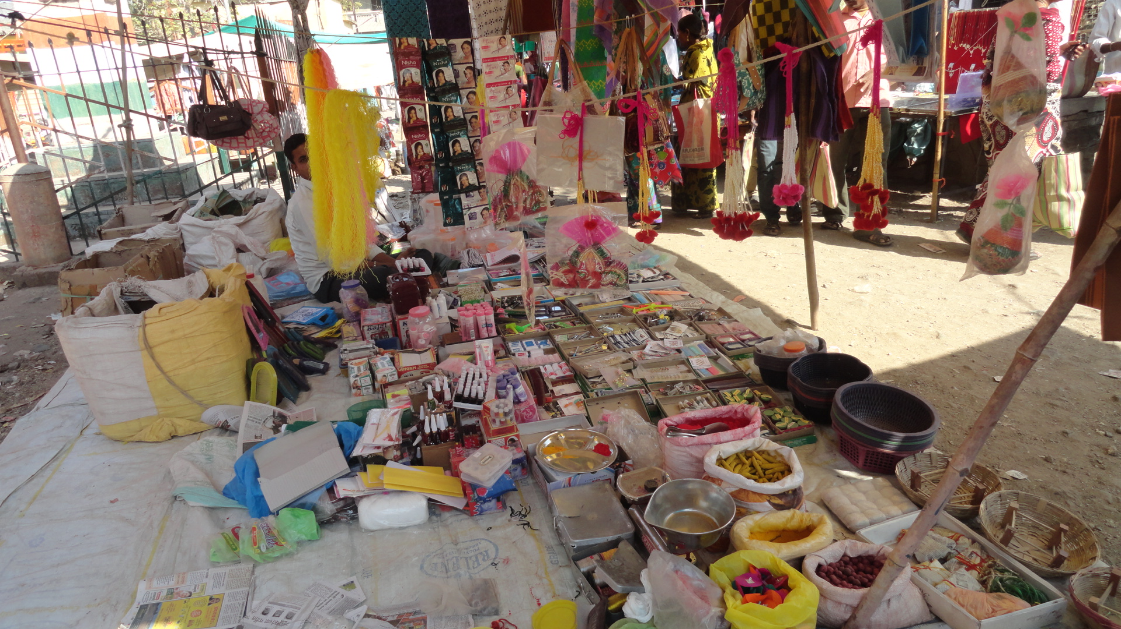
Village life: various dimensions

Slide 13
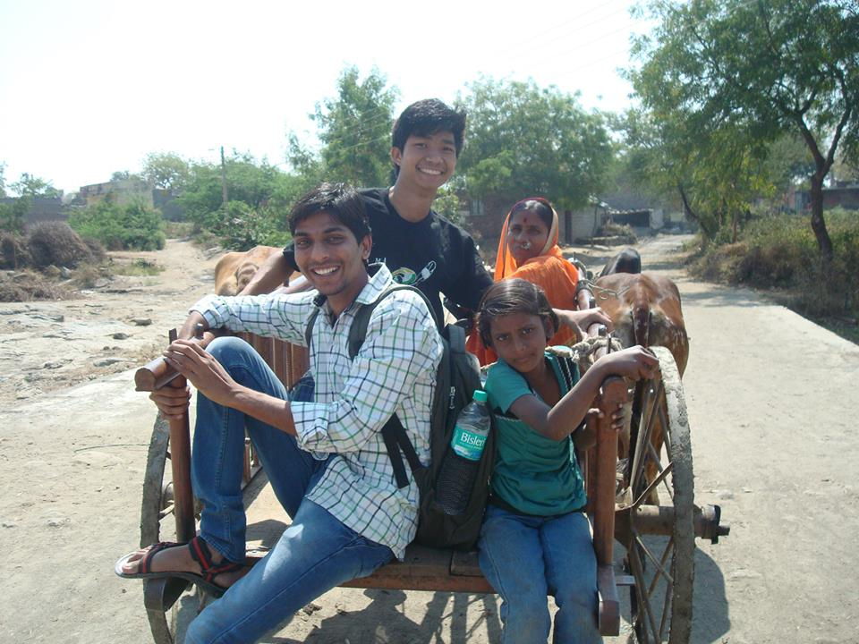
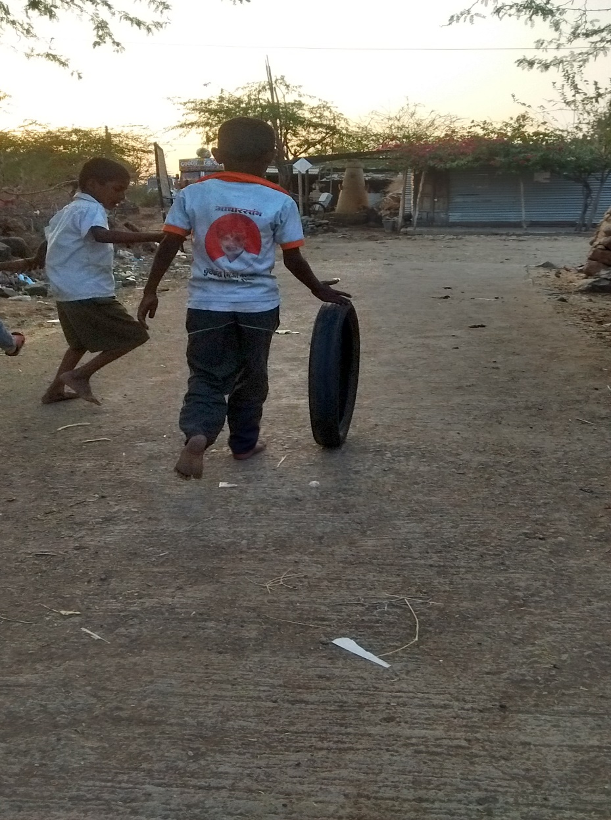
Joy of small things

Slide 14
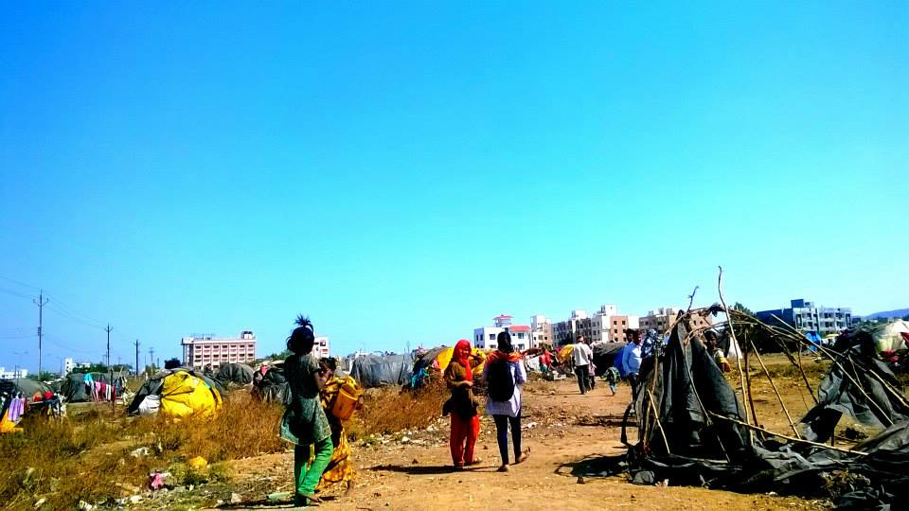
‘Home’ of the homeless

Slide 15
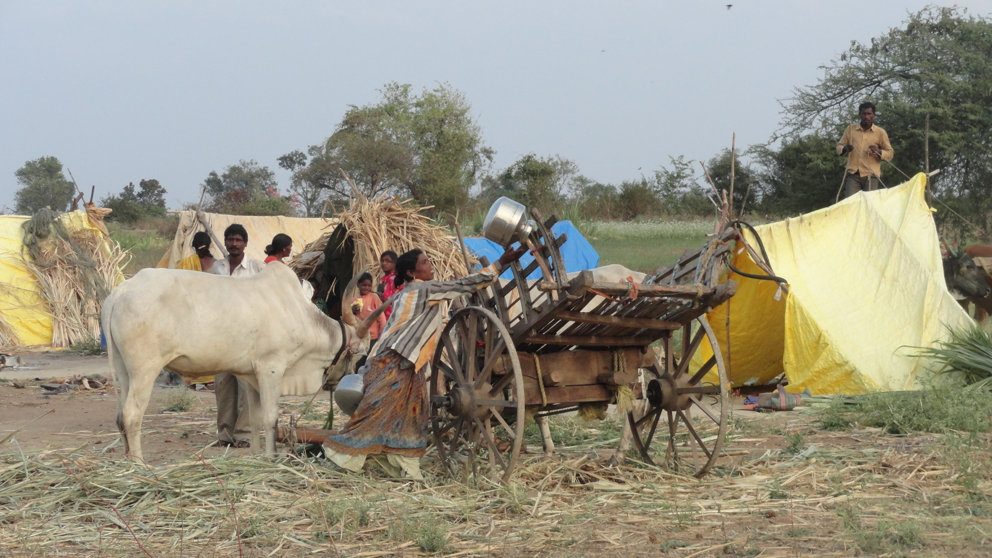
Everyday struggles

Slide 16
THANK YOU

